Slide 1
Group - 2
Project - 218
Presenting
Project Name – Bankruptcy Prevention

Slide 2
Team Members
Shunottara Alhat
Shital Auti
Ananya Biswas
Pratiksha Deshmukh

Slide 3
Business Objective
This is a classification project, since the variable to predict is binary (bankruptcy or non-bankruptcy). The goal here is to model the probability that a business goes bankrupt from different features.
The data file contains 7 features about 250 companies
The data set includes the following variables:
industrial_risk: 0=low risk, 0.5=medium risk, 1=high risk.
management_risk: 0=low risk, 0.5=medium risk, 1=high risk.
financial flexibility: 0=low flexibility, 0.5=medium flexibility, 1=high flexibility.
credibility: 0=low credibility, 0.5=medium credibility, 1=high credibility.
competitiveness: 0=low competitiveness, 0.5=medium competitiveness, 1=high competitiveness.
operating_risk: 0=low risk, 0.5=medium risk, 1=high risk.
class: bankruptcy, non-bankruptcy (target variable).

Slide 4
Project Flow
Understanding business problem
Collection of data
Cleaning of data
Exploratory data analysis
Model building
Model deployment

Slide 5
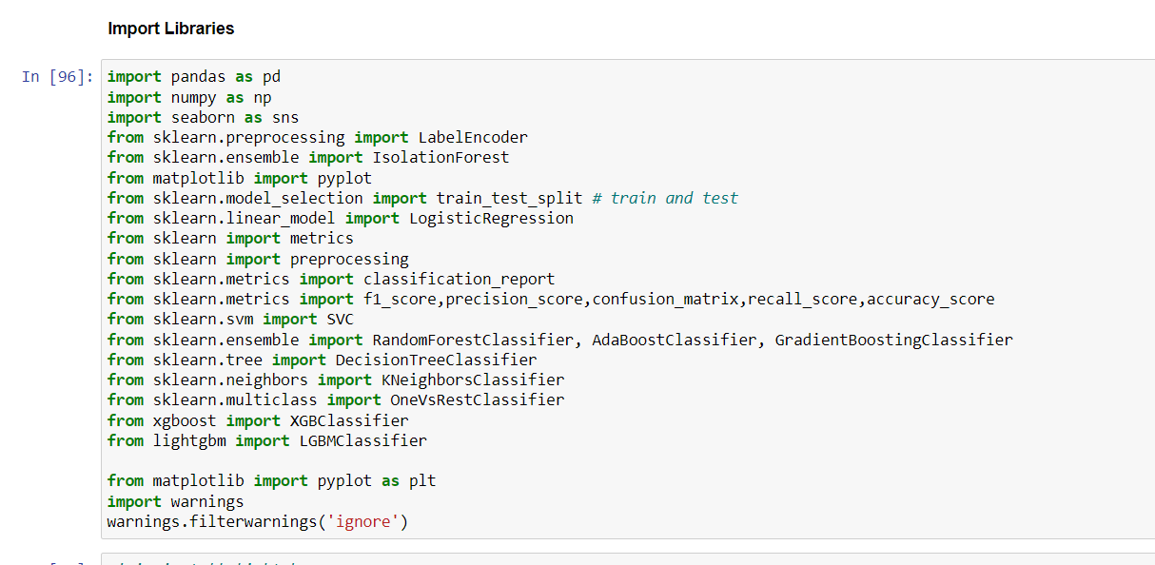
Import Libraries

Slide 6
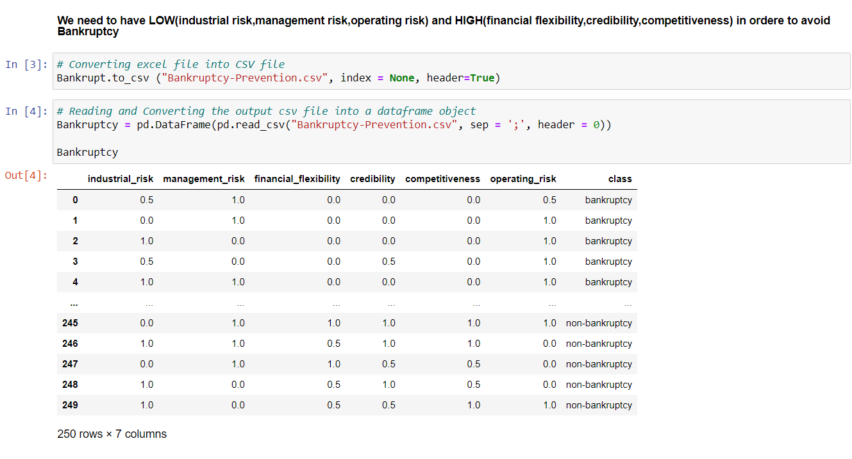
Import Data

Slide 7
Exploratory Data Analysis
As we Observed the data there are not any kind of null values and duplicate values in the data.
In Correlation Matrix we can see no columns are correlated to each other neither input variables (Check Next Page)

Slide 8
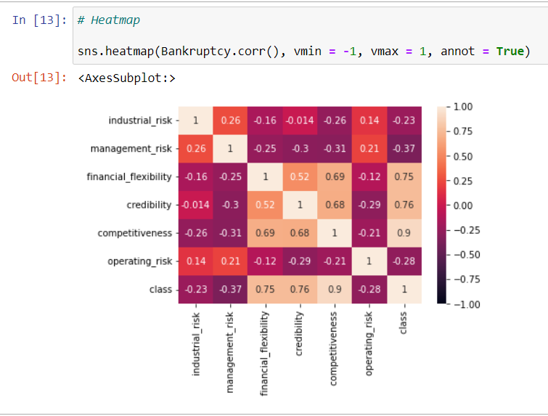
Correlation

Slide 9
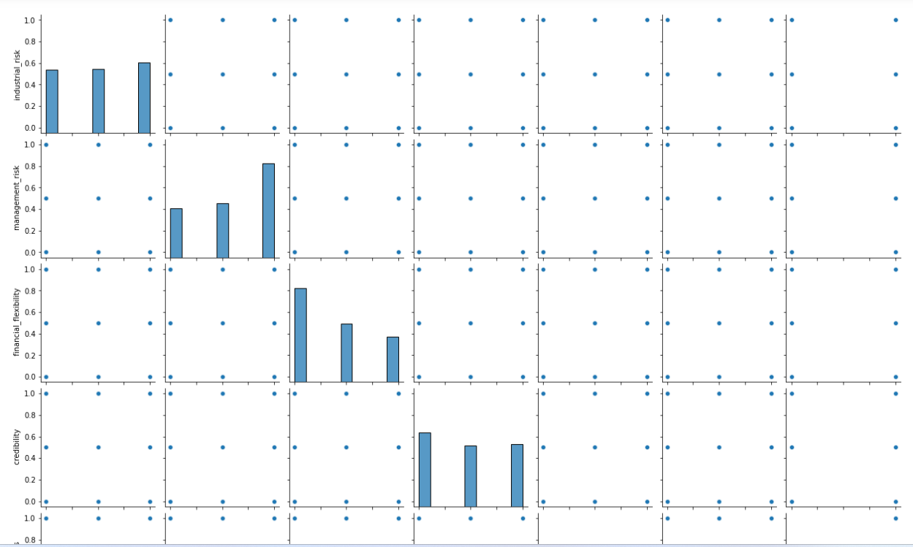
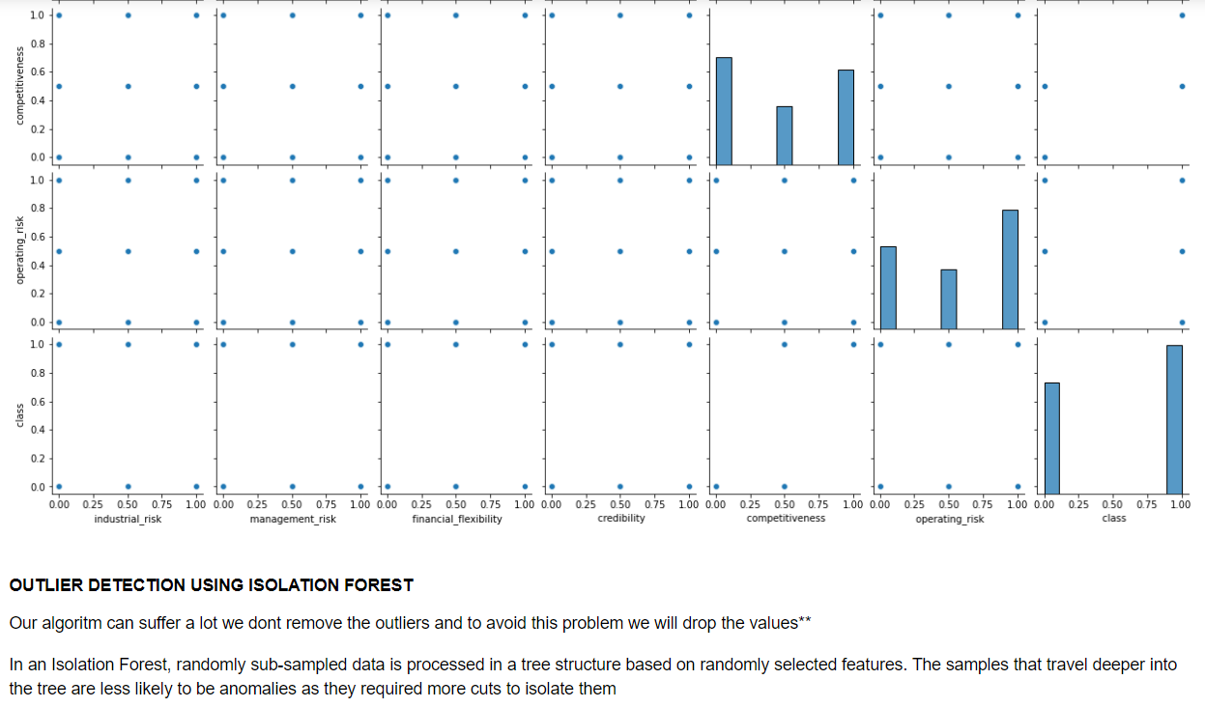
Outlier Detection and Data Visualization
Pairplot

Slide 10
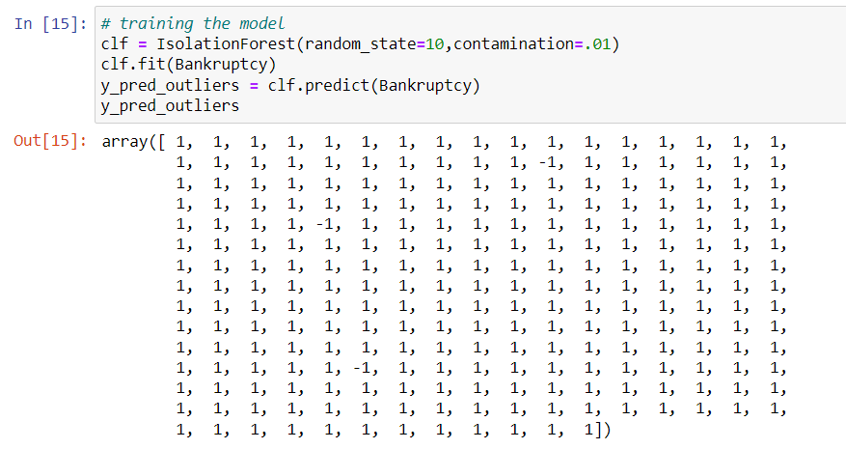
Outlier Detection Using Isolation Forest

Slide 11
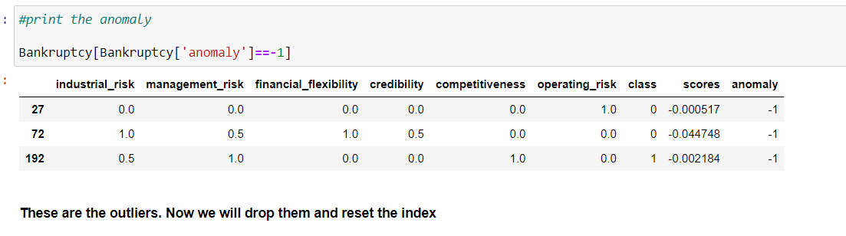
We detect 3 Outlier

Slide 12
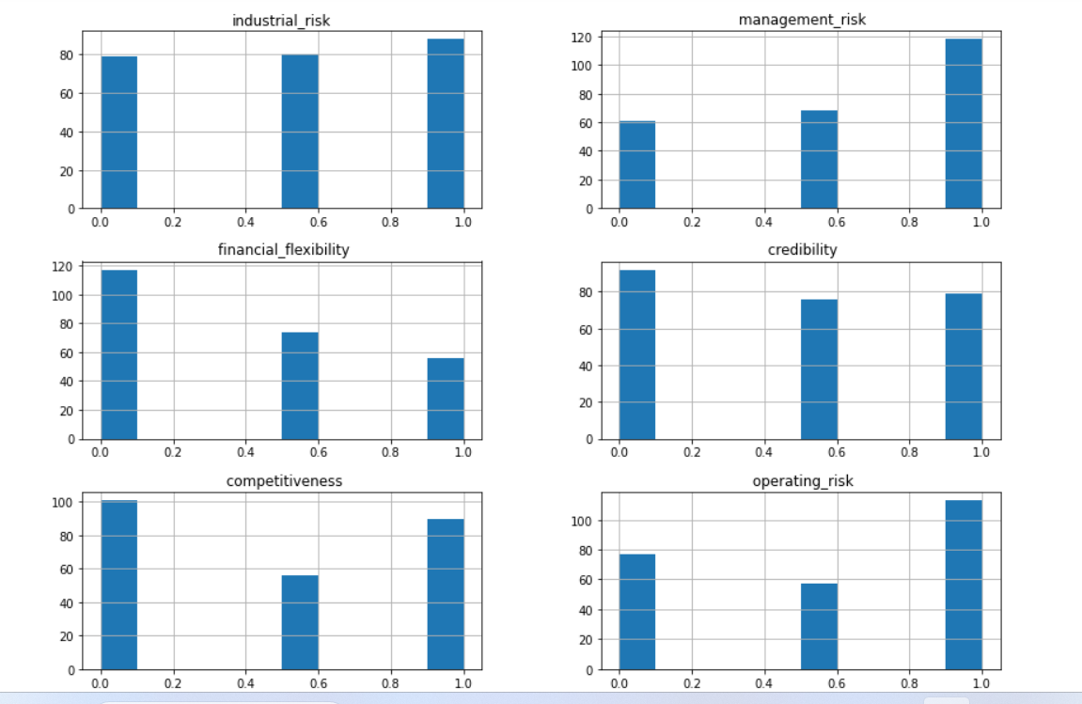
Univariate Histogram

Slide 13
Model Building

Slide 14
We Used 9 Model (Algorithm)
Random Forest Classifier
K Neighbour Classifier
Decision Tree
Gradient Boosting Classifier
Light Gradient Boosting Classifier
Support Vector Machine Classifier
Logistic Regression Classifier
AdaBoost Classifier
Xtream Gradient Boosting Classifier

Slide 15
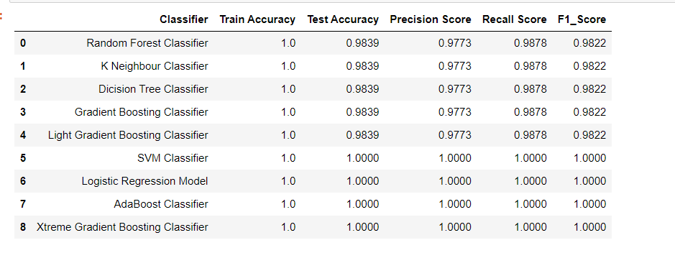
Model Evaluation

Slide 16
Final Best Model
From all 9 Models we choosed “Support Vector Machines” as Final Best Model
Because it gives Good Accuracy i.e “100%”.
SVM tries to find the best margin(distance between the line and support vector),that separate the classes and reduces the risk of the error on the dataset.
SVM is best for small Dataset.

Slide 17
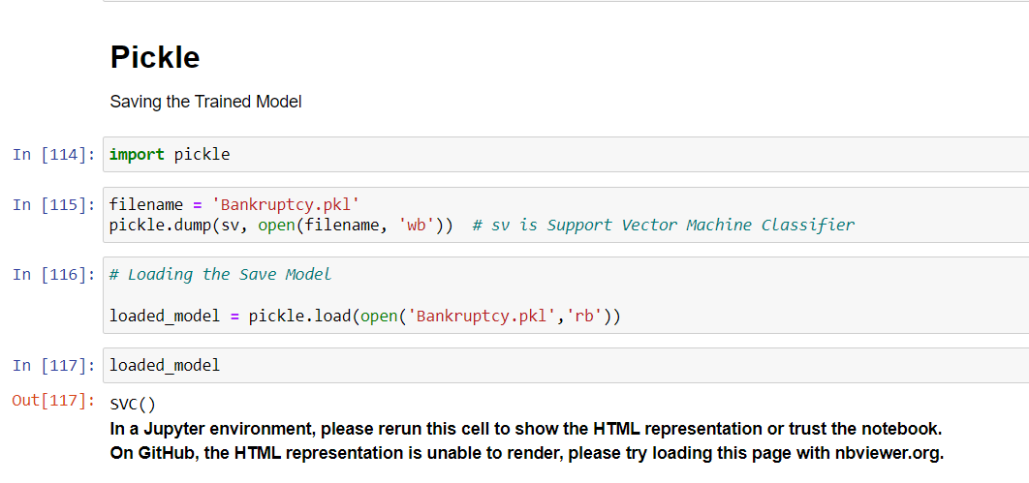
Pickle

Slide 18
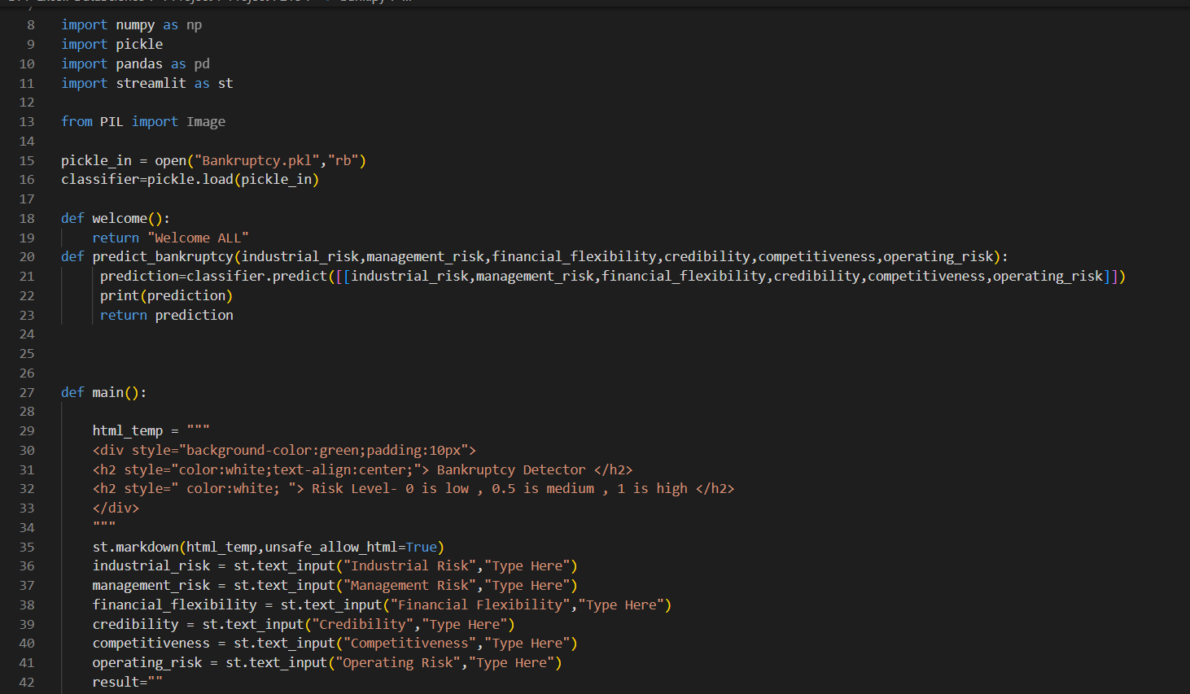
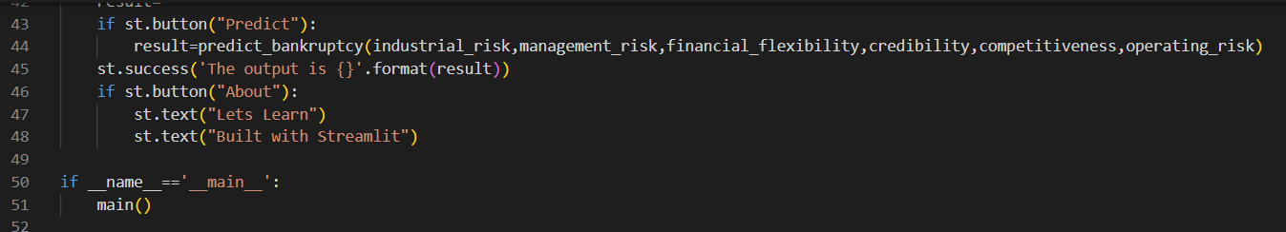
Deployment

Slide 19
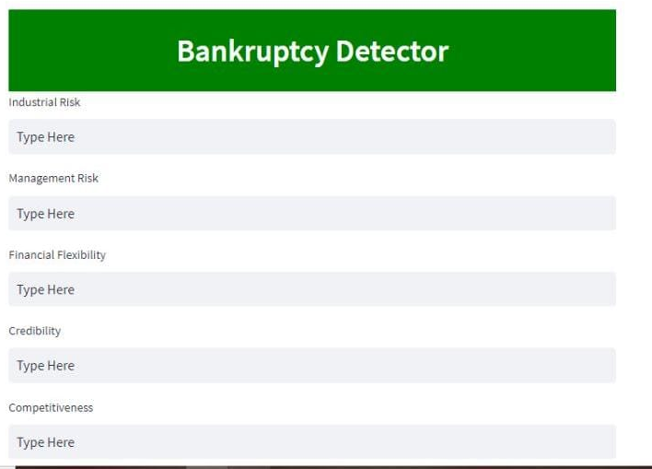
Deployment

Slide 20
Challenges Faced

